Slide 1
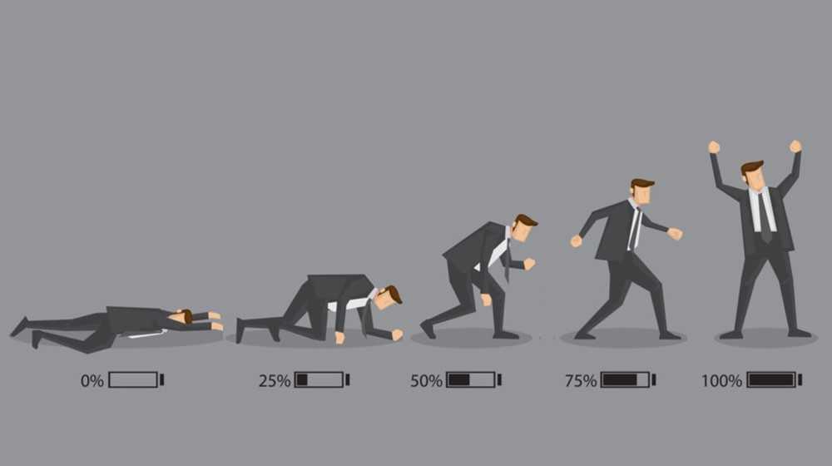
Personal & Sustainable Strategies to Prevent Work-Related Burnout
Major: Applied Computing, Minor: Consciousness & Creativity
By: Gabriel Smith-Dalrymple
Introduction:
Give a brief overview of the project and why it matters
Process:
Interviewed a dozen software development professionals and asked them to describe their experiences with burnout.
Each person was asked to describe burnout in their own words, describe the signs they present when burning out and while burnt out, then explain what practices they use to prevent burnout, and what they do to break out of burnout.
Results:
Summarize the results section of my paper here
Conclusion:
End with a thoughtful piece of advice that wraps everything up.
Background:
Explain why I decided to do this project
Design:
Talk about the design decisions that led to the final project
University of Washington | Bothell

Slide 2
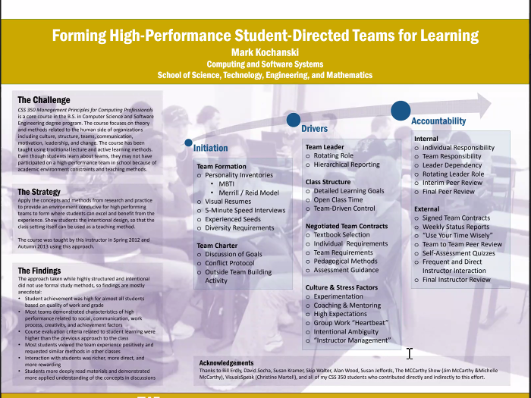

Slide 3
Add slide that introduces myself, and ties my topic to the idea of understanding an industry
Personal strategies to prevent burnout in software development
Introduces topic and a few key points
Notes:
Maybe change the box color or reduce transparency of boxes
Break process/results into bullets
Upload another draft of this poster, and email it to mark to get more comments (Deadline: Monday, 12/13, @Noon)

